Slide 1
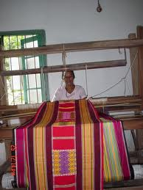
UNIT 6 ORGANISATION OF THE FACTORS OF PRODUCTION
COTTAGE INDUSTRIES

Slide 2
Objectives
Define Cottage industries.
Identify the features of cottage industries.
Identify resources used in cottage production.
Identify the various advantages of cottage industries to the employer.
Identify the various advantages of cottage industries to the employee.
Identify the various advantages of cottage industries to the country.
Identify the various disadvantages of cottage industries to the employer.
Identify the various disadvantages of cottage industries to the employee.
Identify the role of government in the development of cottage industries.

Slide 3
Review of Lesson 18
Define Subsistence Production.
Define Domestic Production.
Define Surplus Production.
Identify the various types of Production.
Differentiate between goods and services .
Identify the branches of production.
Identify the sequence of the division of production.
Identify the natural resources of the Caribbean.

Slide 4
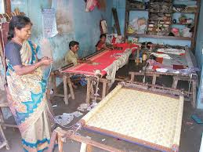
COTTAGE INDUSTRIES
This refers to skilled production of a handicraft nature done at home.
Cottage production may be carried out as a means of self-employment or employers may give out work to employees in their homes.

Slide 5
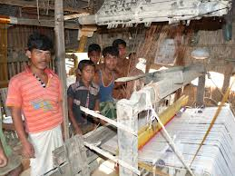
Features of Cottage Industries
Simple machines and tools are used.
Initially outlay of capital is required.
Cottage industries utilise local raw materials in the production process.

Slide 6
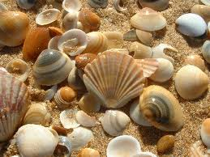
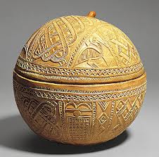
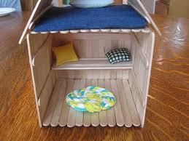
Resources used in cottage production
Sea Shells
Calabash gourds
Straw
Boxes
Vegetables
Metals
Plastic bags and bottles
Plastic cups
Match Sticks
Fudge Sticks
Fruits
Threads, etc

Slide 7
Advantages of Cottage Industries to the Employer
It reduces the investment capital required by the employer since he does not have to set up an organised factory.
The employer does not have to keep workers in his employ during periods when there is low or no demand for his products.
The employer does not have to fear strike action of workers due to trade union activity as he deals with employees on a one on one basis.

Slide 8
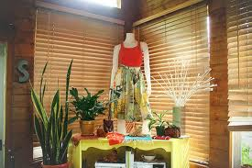
Advantages of Cottage Industries to the Employee
The worker can work at home at his own pace.
The worker can get help from other family members.
Cottage production can be a means of self-employment.
It can also be a means of additional income.

Slide 9
Advantages of Cottage Industries to the Country
Cottage industries provide a source of employment.
It reduces the importation of souvenir items for use in the tourist and other trades.
Cottage industries can be a major source of earning foreign exchange by means of direct export of these goods to other countries.
It allows the development of human resources.

Slide 10
Advantages of Cottage Industries to the Country continued
Cottage industries creates linkages which will assist in the growth and development of some sectors of the economy.
Cottage industries grow and develop into big businesses.
Increased production in cottage industries will cause an increase in the country’s Gross Domestic Production.

Slide 11
Disadvantages of Cottage Industries to the Employer
Employees may not finish work given to them on time.
Employees may spoil the work given due to lack of supervision.
There may be a lack of standardisation.
Wastage of resources may occur when mistakes are made.
Transportation and other costs may be high in order to pick up raw materials and drop off finished goods.

Slide 12
Disadvantages of Cottage Industries to the Employee
Employees may not get any work thus suffering from lack of income.
The workers have to put in long hours to make a living.
The quality and quantity of products compete with goods produced in a well equipped factory.
Workers may not assess the cost of production correctly and charge lower rates for the items produced.

Slide 13
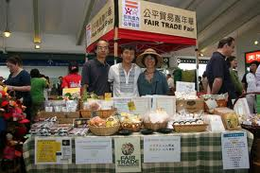
The Role of Government in the Development of Cottage Industries
Providing training in areas such as handicraft through community centres.
They also provide factory space and small loans through their various lending agencies.
Governments provide marketing facilities by organising trade fairs and expositions.

Slide 14
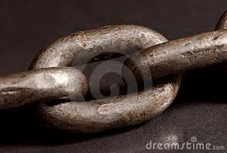
Preview of next lesson
Where do I get my raw materials or who uses my products?

